Slide 1

‘Web development of a virtual Dota 2 Pre-game assistant using Statistical Intelligence’
Collection and/or gathering of DotA 2 (MOBA) match data
2. Analyse the data with the help of statistical intelligence
3. Develop a Web Application that visually highlights the
meaningful components of the collected data set
4. Offer a coach-like pre-game strategic recommendation
Sixiang, Qiu
Information technology
Notes:
Hello, everyone, my name is Sixiang, Qiu, a student from Information technology.
What I am doing today is to give you a presentation about the project what I am working on to get my BA degree.
The project, namely, is a web development of a virtual Dota2 Pre-game assistant using Statistical Intelligence.
which is mentioned above the slide, while at the bottom is the full version of task descriptions.
First, what we do is collecting data from DOTA2 matches
Then data is analyzed and visualized to offer users the recommendation.

Slide 2
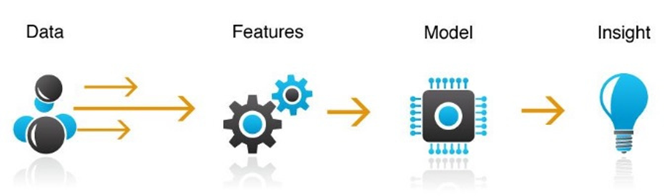
Statistical intelligence
Machine learning
Notes:
Well, from my perspective, the whole project is concerned with the field of machine learning instead of statistical intelligence.
We use the term for descriptiveness.
So, now let’s talk about the project in detail with machine learning technology.
The collection of original data remains the same while after that, we investigate the features beneath the data.
Then we put those features into machine learning algorithms.
We train the model, and we visualize it on a website.
The model would tell everything for us.
Before heading to the next slide, one more question. What is DOTA2? Why does it have to be DOTA2?
Well, there’s actually two questions.
From Wikipedia, Dota 2 is a multiplayer online battle arena (MOBA) video game which does not explain anything.
I will do the job for it.
Ok, back to the slide of machine learning methodology. Minutes ago, we get a insight into the website, now let’s dig into the process how we get to this place. First of all, it is the data collection module.

Slide 3
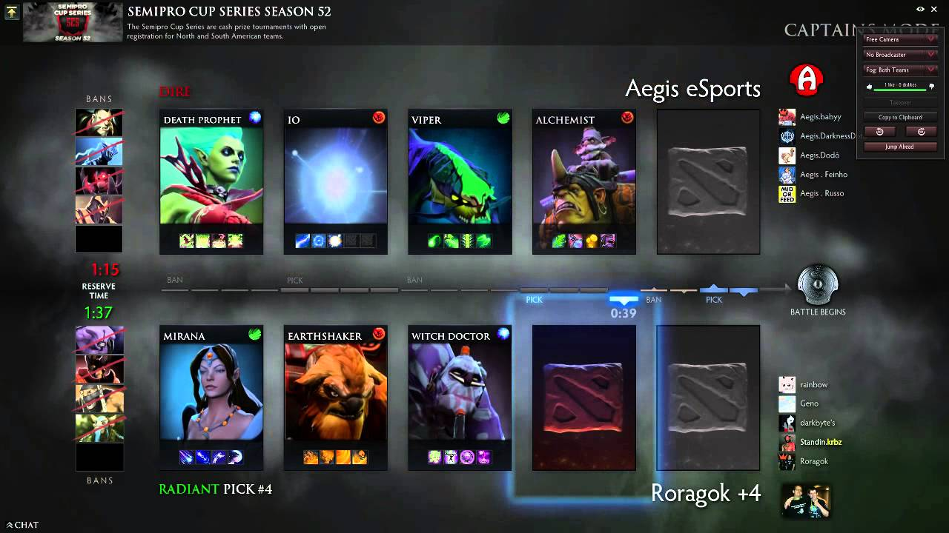
DOTA2
Notes:
Yes, DOTA2 is a typical MOBA game with general players around the world.
In a DOTA2 game match. We always begin with picking hero to fight against another teams. Two teams both consists of 5 players with 5 heroes.
See, two teams and ten players.
And this is exactly one of the hero picked by player, namely earth shaker.
Who is it?
Every pick of the hero should follow a strategy in order to win the game.
Same to a soccer match, in which we need forward, we need backward and we need a goalkeeper.
In a DOTA2 match, Well, earth shaker is a support. Witch doctor is a support too. Then this team would have to pick some of the heroes with the characteristics of carrying the team instead of supporting. Mirana can do part of the job of carry but not enough.
IO, support. Viper, carry. Alchemist, carry. There should be a powerful nuker to destroy the enemy team.
So, this is what we called the hero combination. Team with more appropriate hero combination takes the victory.

Slide 4
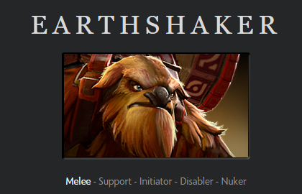
Characteristics
Notes:
This time, the official website of DOTA2 provides answer to us.
On the website, the hero earth shaker is defined by its characteristics.
I’m going to explain some of the typical characteristics to you.
A melee is a hero who fight against its enemies in close range.
A support means this hero is responsible for auxiliary job in the team.
Another one is the nuker which means this hero is able to provide dozens of damage to the enemies.
Now we back to the previous slide.

Slide 5
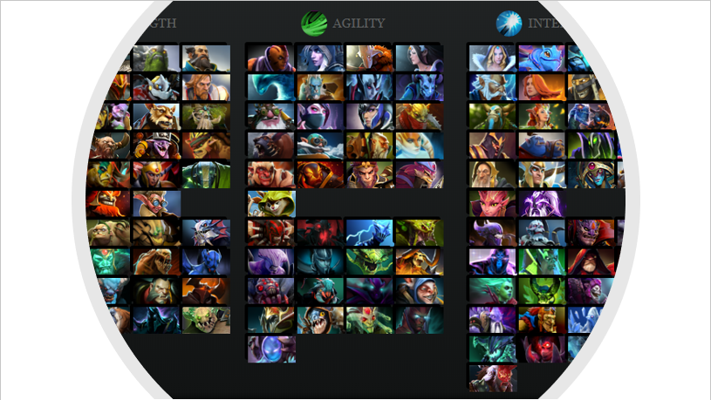
Notes:
Until the finish of the project, there’s up to 119 heroes in DOTA2 with their own characteristics.
Among them, it exists tens of thousands of hero combination.
Coach can decide for the player which hero to pick so that probability to win the game is thus enhanced.
Now, we develop application for amateur players, like me, to have their personal coach teaching them
How to win the game from the beginning.
Now, let’s see what we got until today.

Slide 6
See demonstration
Notes:
Here’s the project folder in Visual studio. Mind that I create folder of virtual environment for consistency of the project on different programming environment. We activate the app.py to open the website. Here we go.
First of all, let's talk about the layout of the website. A navigation bar is put on the top of the window with the name of project, Combat simulator of DOTA2. then, the main content of the website imitate those hero picking interface in DOTA2 where two teams are divided horizontally. The radiant on the top while the dire on the bottom. Radiant and dire are the names of two camps in DOTA2.
Same to DOTA2 interface, Ten players are also split into ten player's windows for them to pick hero. Of course, the website by now is set responsive to resizing event of browser for convenience of those smaller monitors.
Between the container of two teams, also, two functions are integrated into two buttons which is the predict button and the recommend button. To activate the buttons, we need to first pick heroes like we do in the game, single click on the player's window would trigger a drop down menu in which 119 heroes are all implemented.
Then, clicking on the hero's name would change the player's window with its name representing that the player has selected a hero. After all heroes have been picked, it is able to click the predict button to see the result of the match held between these ten heroes. Oops, it seems like error happen that duplicate heroes are selected, since DOTA2 does not allow duplicate heroes appear in one single match, we have to valid the input.
Ok, it is now available. After prediction, the container changes its background colour in accordance with the probability of it. the probabilities is consoled on the browser. lets see.
The value in Object 0 stands for the probability of the radiant. The value in Object 1 stands for the probability of the dire.
Now, if users would like to know the recommendation about how to win the game.
Just double click on the player's window to reset the picked hero. Well, I think this is not a good choice, how would the browser recommend?
As can be seen, the hero named Spectre is recommended. Change it and we predict.
Ok, so far for the demonstration, let’s back to the reality.

Slide 7
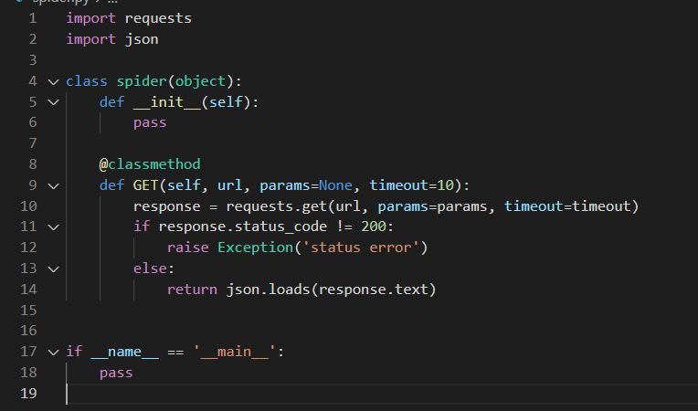
Data collection
A simple spider class to perform request from open API of Dota2 matches:
www.opendota.com
Notes:
This is the Python program serving for collecting data. It's merely a requesting module which generate URL for the main class to request the API. Besides, we use opendota which is a third party API for DOTA2 matches.

Slide 8
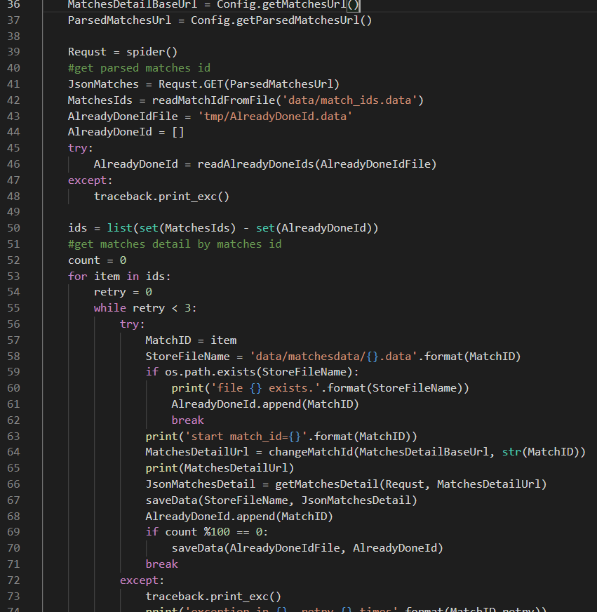
Storage module of data collection
Notes:
Heading to the storage module, URL dispatched and requested in the requesting module yields match to be stored. Through this module, match with duplicate match ids would be sensed and thus not stored in the storage file.
However, the raw data which we collected is not a correct format to be used. Perhaps, it is not revealed from the implementation. Let's see how it actually looks like.

Slide 9
Elements | Data Type
Match id | Integer
Match version | Float
Match start time | Float
Game server | String
Duration | Float
Radiant win | Boolean
Skill level | Integer
Player_0 hero id | Integer
Player_1 hero id | Integer
Player_2 hero id | Integer
Player_3 hero id | Integer
Player_4 hero id | Integer
Player_5 hero id | Integer
Player_6 hero id | Integer
Player_7 hero id | Integer
Player_8 hero id | Integer
Player_9 hero id | Integer
Needed
Notes:
This is the format of an entry of raw data. What we need is the ten heroes picked by players and the result of the match.
In this table, that stands for the Boolean variable of radiant win and the integer variable of ten hero ids.
To get what we need, here we go the pipeline definition.

Slide 10
Pipeline definition
Feature
Original data
Pipeline
Operatable data
Notes:
Illustrated from the figure, from original data, a pipeline is implemented to convert it to format which is more operatable. The operatable data format stands for features for example, the hero combination of two teams is exactly one of the features.

Slide 11
Elements | Data Type
Team0 hero id 0 | Integer
Team0 hero id 1 | Integer
Team0 hero id 2 | Integer
Team0 hero id 3 | Integer
Team0 hero id 4 | Integer
Team1 hero id 0 | Integer
Team1 hero id 1 | Integer
Team1 hero id 2 | Integer
Team1 hero id 3 | Integer
Team1 hero id 4 | Integer
Label | Integer
Notes:
Now, we have the correct form of the data, ten heroes and the label element representing the result of the match.
Then, we need to transfer it to its features. That includes a question that, how does the machine learning algorithms recognize all these hero ids as features?

Slide 12
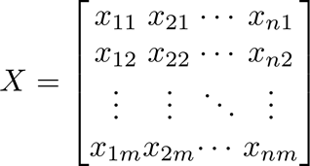
Output = match result
Samples = 50,000
Features = 119 heroes * 2 teams
Input = Features
Notes:
From up to 50,000 data that has been collected, we integrate them into a dataset which can be described in the form of a matrix like this. Each data yields for a sample being placed vertically in the matrix with an input and an output placed horizontally.
The easier one to understand is the output which is exactly the result of the match, win or lose that is a 0 or 1 integer.
As for the input, machine learning algorithms cannot recognize heroes combination from only hero ids. So, all 119 heroes are placed horizontally twice for two teams to represent their own features. Heroes picked in the sample will result in an integer 1 in the feature matrix while 0 if not picked.
So far, the pre-processing is done. However, model trained with barely heroes combination of two teams as features result in bad performance which means more features should be implemented to the dataset. From domain knowledge of DOTA2, beside from hero combination of two teams. combination with lesser heroes also has great impact on the result of the game.

Slide 13
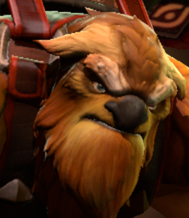
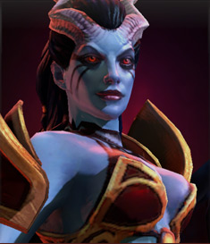
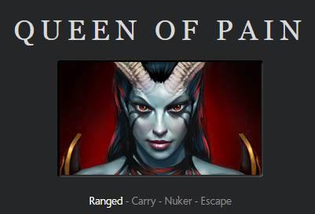
Hero combo
From the domain knowledge of DOTA2, combined of two heroes can also impact on the result of the match.
Earth shaker
Queen of pain
Notes:
Let's say earth shaker which is quite familiar with us, with queen of pain which is labelled as a ranged carrier nuker. So, both of them deals tons of damage while the earth shaker can be the support of the team and queen of pain can be the carrier. This is like a killer combo in the game. Teams with these two heroes tend to have more probability to win the game. Therefore, it is considered feasible to add hero combo as an additional feature to the dataset matrix.

Slide 14
Top-50 Hero combo
Hero id | Count | Hero id | Count | Hero id | Count | Hero id | Count | Hero id | Count
86-8 | 658 | 107-55 | 442 | 85-76 | 401 | 84-8 | 376 | 84-74 | 356
86-96 | 633 | 86-93 | 438 | 85-26 | 401 | 7-39 | 376 | 79-9 | 354
86-106 | 603 | 87-8 | 433 | 7-25 | 401 | 28-8 | 375 | 90-106 | 353
51-11 | 576 | 121-8 | 432 | 7-10 | 400 | 41-74 | 375 | 86-16 | 351
91-19 | 528 | 72-86 | 423 | 82-74 | 397 | 107-8 | 373 | 20-6 | 349
86-11 | 526 | 86-54 | 418 | 79-48 | 389 | 28-87 | 373 | 85-15 | 348
86-39 | 478 | 28-54 | 415 | 86-13 | 385 | 7-12 | 369 | 85-12 | 346
86-17 | 467 | 31-8 | 412 | 84-104 | 382 | 7-17 | 367 | 100-72 | 346
86-46 | 465 | 86-10 | 408 | 84-95 | 380 | 55-106 | 364 | 86-23 | 346
39-7 | 447 | 55-87 | 408 | 16-8 | 379 | 7-23 | 364 | 41-86 | 344
Notes:
In this project, We believe that the more numbers of appearance of a certain hero combo, the more powerful the hero combo is. Therefore, statistical method is used to record the top-50 hero combo appears in the dataset.

Slide 15
Top-50 Hero combo
Hero id | Count | Hero id | Count | Hero id | Count | Hero id | Count | Hero id | Count
86-8 | 658 | 107-55 | 442 | 85-76 | 401 | 84-8 | 376 | 84-74 | 356
86-96 | 633 | 86-93 | 438 | 85-26 | 401 | 7-39 | 376 | 79-9 | 354
86-106 | 603 | 87-8 | 433 | 7-25 | 401 | 28-8 | 375 | 90-106 | 353
51-11 | 576 | 121-8 | 432 | 7-10 | 400 | 41-74 | 375 | 86-16 | 351
91-19 | 528 | 72-86 | 423 | 82-74 | 397 | 107-8 | 373 | 20-6 | 349
86-11 | 526 | 86-54 | 418 | 79-48 | 389 | 28-87 | 373 | 85-15 | 348
86-39 | 478 | 28-54 | 415 | 86-13 | 385 | 7-12 | 369 | 85-12 | 346
86-17 | 467 | 31-8 | 412 | 84-104 | 382 | 7-17 | 367 | 100-72 | 346
86-46 | 465 | 86-10 | 408 | 84-95 | 380 | 55-106 | 364 | 86-23 | 346
39-7 | 447 | 55-87 | 408 | 16-8 | 379 | 7-23 | 364 | 41-86 | 344
Notes:
From the table, earth shaker with queen of pain appears 447 times indicating that it is exactly a quite powerful hero combo in player's opinion. So, now the dataset matrix is expanded with the new feature hero combo.

Slide 16
Output = match result
Samples = 50,000
Features = (119 heroes + 50 hero combos) * 2 teams
Notes:
The feature expands from 238 to 338 dimensions.
However, Statistical method is considered an unsupervised method which learns the pattern beneath the dataset only from the degree of input regardless of the output which is the result of the match.
It only helps us to learn about the features. In the circumstance that we need to know the relationship between features and the match result in order to provide prediction and recommendation.
We need to apply supervised learning methods to train the model

Slide 17
Training
dataset
Validation
dataset
Test
dataset
Notes:
Before training, the dataset is also split into three parts with three unique usages. That is the training dataset, the valiadtion dataset and the test dataset.

Slide 18
Training
dataset
Where machine learning algorithms would try to learn the pattern of the dataset from its features’ input to its output.
Notes:
When machine learning algorithms are first implemented, they are applied on the training dataset to learn the pattern from features to the result of the match.

Slide 19
Validation
dataset
Where machine learning algorithm is fine-tuned in order to perform its full potential.
Notes:
In order to stimulate all the potential of an algorithm, it is applied on the validation dataset which fine-tunes the performance of the model.

Slide 20
Test
dataset
Contains data which is unfamiliar to the model trained in order to simulate real-world environment to test and evaluate the performance of model trained.
Notes:
In the end, the test dataset serves for simulating real-world environment for the model trained. Samples in test dataset have never been seen for the model, thus the prediction result of the model on test dataset would be valuable from degree of evaluation.

Slide 21
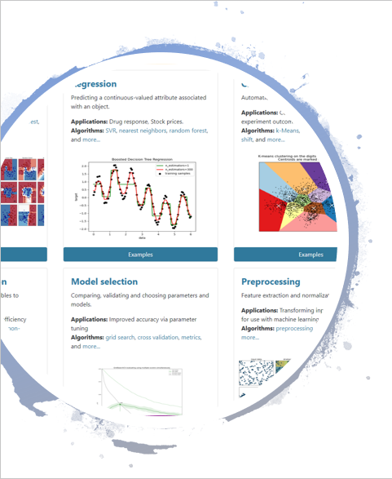
Model metrics
Use Scikit-learn to perform machine learning algorithms
sci-kit learn:
Simple and efficient tools for predictive data analysis
Accessible to everybody, and reusable in various contexts
Built on NumPy, SciPy, and matplotlib
Notes:
In this project, instead of implementing algorithms manually, Scikit-learn is introduced which is a rather powerful Python library containing dozens of pre-defined unsupervised and supervised algorithms in it. Also, using Scikit helps for others to practice or commit to the project. Among dozens of algorithms, three supervised ones are selected to train the model respectively.

Slide 22
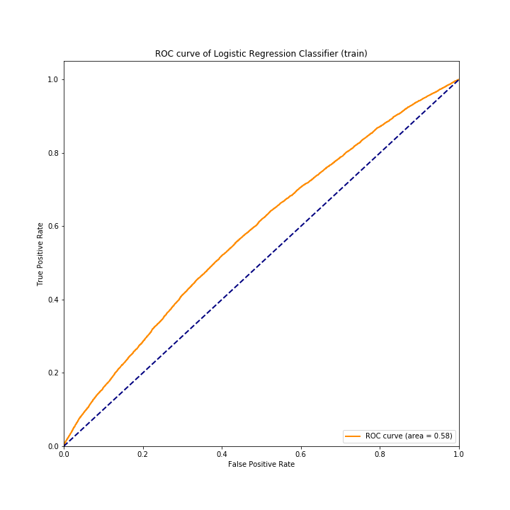
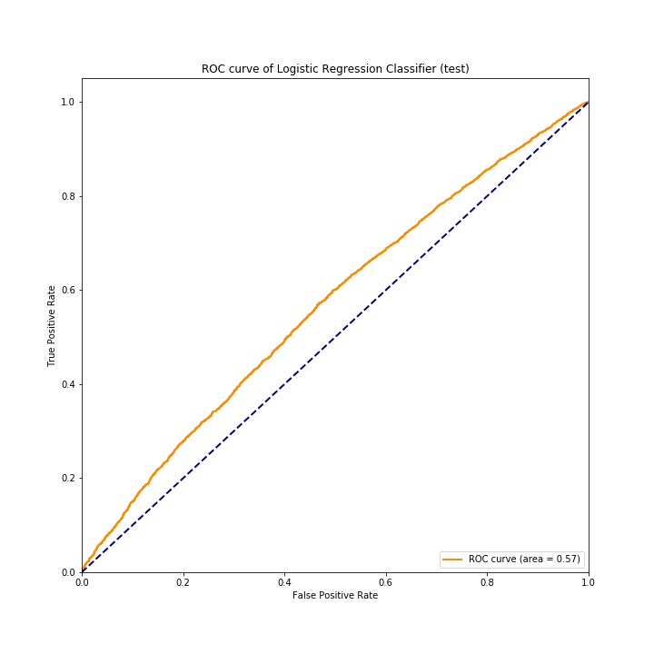
Logistic Regression
ROC: as below
AUC: 0.58 → 0.57
Train
Test
Notes:
The first one is LR, it is an algorithm that works well on linearly separable dataset. The result of model trained with LR is evaluated with ROC and AUC which is quite common as for an evaluation tool.

Slide 23
ROC/AUC
Notes:
Let’s first introduce the concept of ROC curve. Take the one from LR model for example.
From the figure, the orange curve is ROC while the blue curve connects the diagonal points.
The AUC stands for the area under the curve that is the area like I am plotting right now.
The larger the value it is the better the performance of model is.
It could be at highest at value of 1 if the curve just wrap the whole diagram which means the accuracy of the model is 100% correct.
As for the AUC of the diagonal curve, which is 0.5, it stands for a randomly prediction accuracy, 50%.
When the value of it is lower than 0.5, the model trained is considered a useless one since I could speak nonsense that which team would win and the accuracy should be 0.5.

Slide 24
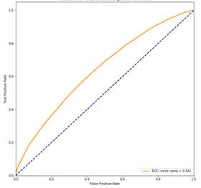
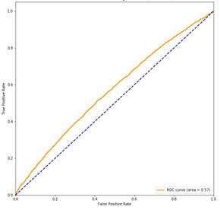
Decision Tree
ROC: as below
AUC: 0.64 → 0.57
Train
Test
Notes:
Besides LR, decision tree is also applied since it works well on nonlinear separable dataset, the ROC/AUC are also shown below.

Slide 25
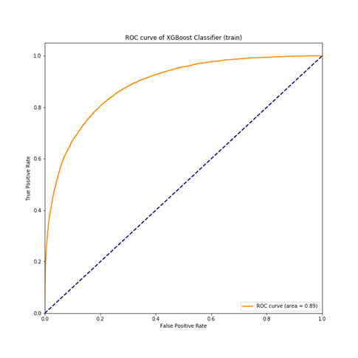
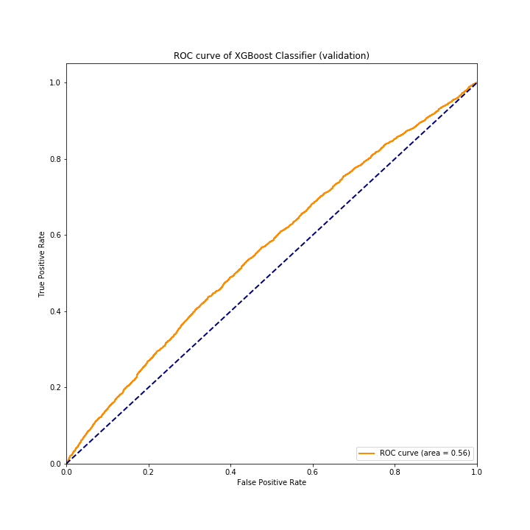
Support Vector Machine
ROC: as below
AUC: 0.89 → 0.56
Train
Test
Notes:
Finally the SVM which could learn the underlying patter of the dataset when there is no much clue about the features.
For all these three algorithms, apparently, they generalize well on the training dataset after validation. However, their performance are worsen when applied on the test dataset. That is the issue mainly caused by overfitting which occurs commonly in machine learning algorithms. To fix it, we fuse the model together.

Slide 26
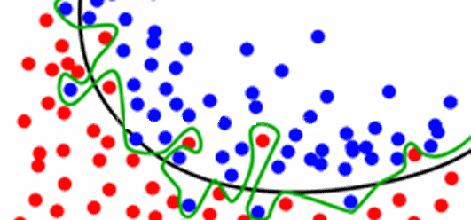
Over-fitting
Notes:
From the figure. Let’s say, red point stands for victory of radiant while blue point stands for the failure.
To predict it correctly, the model fit to the points which yields the green boundary in the figure.
However, the black decision boundary has actually better results.
That is because in the real-world, which is the test dataset, there’s not that much data to simulate the green boundary.
It is too sophisticated while the black one would have better generalization capability which results in good performance on test dataset.
By model fusion, multiple models are fit and averaged. As a result, the green boundary moves closer to the black one.

Slide 27
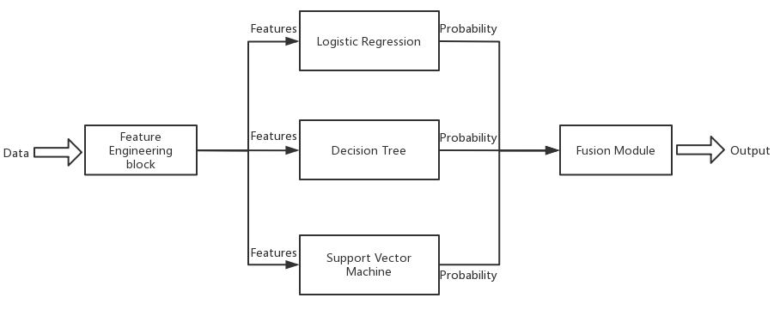
Weights
Notes:
One of the model fusion strategies is weighted average of different models.
By distributing weights before each of the sub-model, it generates a fused model yielding for higher performance.

Slide 28
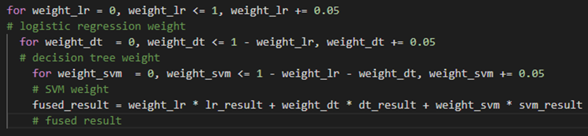
Notes:
The weight distribution rule is determined by traversal functions.
We tried exhaustively on each situation of weight distribution, and got the optimal.
This is a demo of the implementation.

Slide 29
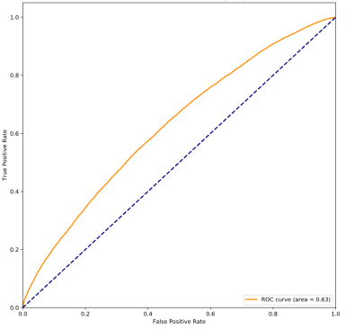
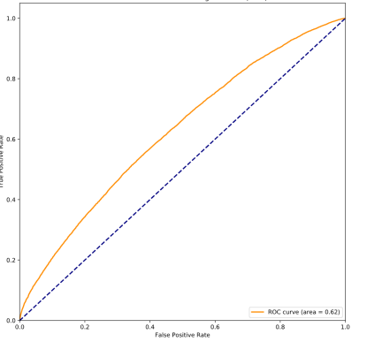
Fused model
ROC: as below
AUC: 0.63 → 0.62
Train
Test
Notes:
For the fused model, its performance is quite stable. It generalizes well on both training dataset and test dataset. The value of AUC stays among 0.63 to 0.62 which is fairly promising as for predictive accuracy of a game match.
Then, the last thing to do is to put the fused model into use in terms of a website. Here we introduce the prediction class which is easier for understand.

Slide 30
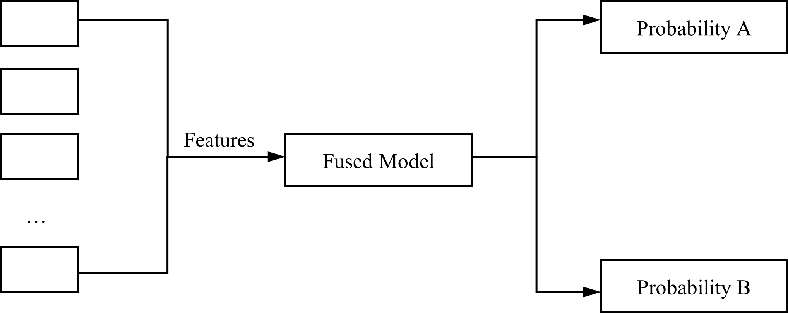
Prediction Class
Notes:
In the prediction class, just like the demonstration, ten heroes are selected and input after pre-processing them to their features.
The fused model obtains the features and thus returning the two-corresponding probability to the website.

Slide 31
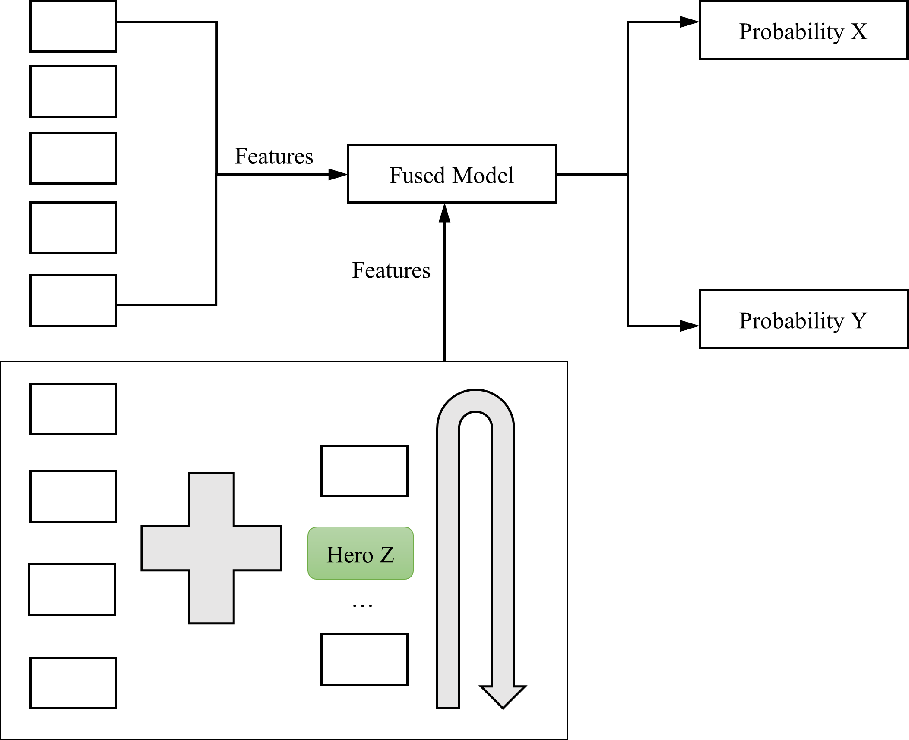
RecommendClass
Notes:
In the recommend class, however, one of the team contains only 4 heroes.
Thus, another hero is added behind the input. Then, it is converted into features and passed into the fused model.
By traversal function, an optimal hero added should yield an optimal probability Y.
Call it Hero Z, it is returned to the website.

Slide 32
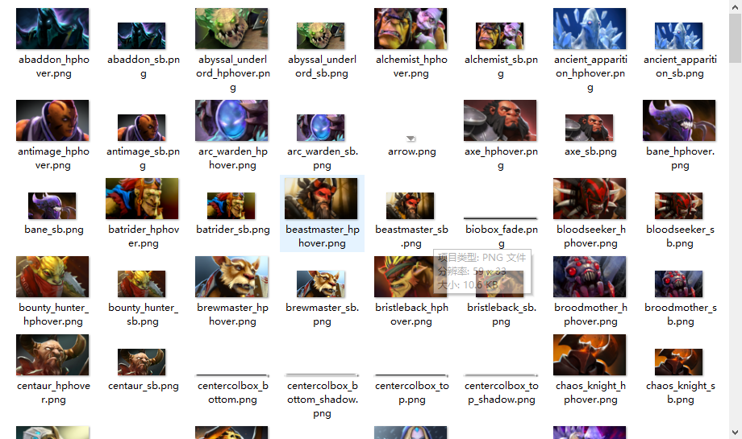
Notes:
In the end, it is an additional slide which I added because it is very sorry to tell that I actually update the project with more characteristic details in the front-end system. However, due to broken hard drive, I could not show it to you today.
As can be seen, the hero icon is currently all obtained so that we could not only figure out the hero by their names.

Slide 33
Thank you
Notes:
So far for this presentation, thank you sincerely for listening.

